Slide 1
Category review: Chips
June 2020
Retail Analytics
Brand note: If client logo is not required, use alternate title page layout right click slide thumbnail > Layout > Title

Slide 2
Notes:
To view Privacy video explaining how important data privacy is to Quantium, please click here: https://www.youtube.com/watch?v=Zq1QDAkoRzU
or here Q:\Company Reference\Brand & Design\Brand videos\Q Privacy.mp4
At Quantium, we believe that data is the behavioural footprint of humanity and that it has to be treated with the utmost care and responsibility.
Histories, attitudes, indeed lives are stored within it in ways that aren’t always apparent – and that’s what makes its potential so powerful.
To work with it responsibly, sensitively, we set ourselves the highest data privacy protection and governance standards.
We have spent 17 years perfecting privacy-by-design and secure-by-design principles. Central to this is not holding any personally identifiable information about people –
we neither receive it, and put the necessary protections in place to be unable to decipher it.
Every aspect of handling data is safeguarded: from its de-identification, to its encryption – data security is paramount and of the highest grade.
We pride ourselves on gaining the trust of iconic organisations around the world through years of securely working with their data,
and in turn the trust that builds with their stakeholders.

Slide 3
Executive summary
Chips Category Review:
1. Mainstream Young and Mid-age Singles/Couples demonstrate the highest per-purchase spending on chips.
2. Older Families (Budget), followed by Young Singles/Couples (Mainstream) and Retirees (Mainstream), collectively contribute to 25% of total sales revenue.
3. 'Kettle' is the dominant brand choice across all stores.
4. 'Doritos' is the preferred brand for Young and Mid-age Singles/Couples, while 'Smiths' leads in other segments.
5. The 175-gram chip size is the most frequently purchased, closely followed by the 150-gram variant across all segments.
6. Transactions for chips experience a significant upswing in the period preceding Christmas, presenting an opportunity for increased sales through strategic promotional offers.
01
02
Store Analysis:
1. During the trial period, stores 77 and 86 exhibited a notable surge in both total sales and customer count in comparison to the control store.
2. Store 88 also experienced an increase, although it was not as substantial as observed in stores 77 and 86.
Task 2
Here you will include your high-level findings and any key callouts for task 2

Slide 4
01
Category

Slide 5
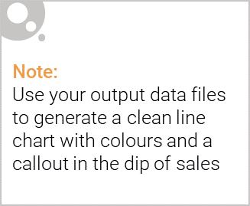
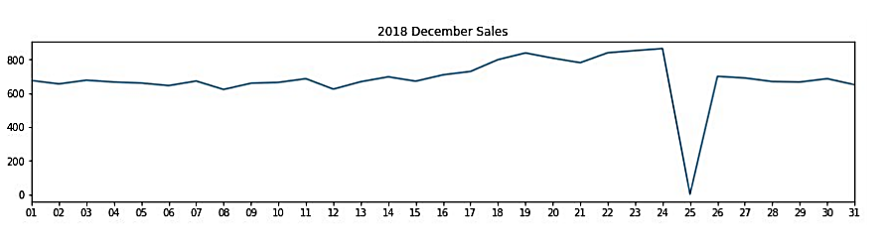
Overview: your key callout for the category should be included here:
On December 25th, a temporary cessation of transactions occurred due to the store being closed for the Christmas holiday, resulting in a decline in sales.
Sales demonstrate a consistent escalation in the lead-up to Christmas day, subsequently reverting to levels akin to early December sales on New Year's Eve.

Slide 6

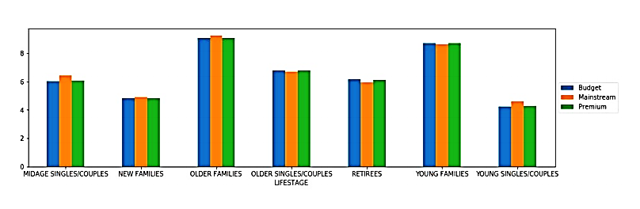
This slide will be commentary on affluence and its effect on consumer buying for the category of chips:
The primary contributors to sales were the Budget - Older Families, Mainstream - Young Singles/Couples, and Mainstream - Retirees segments, collectively accounting for 25% of the total sales revenue.
Both the Older and Young Family segments demonstrate the highest average purchase units per unique customer.

Slide 7
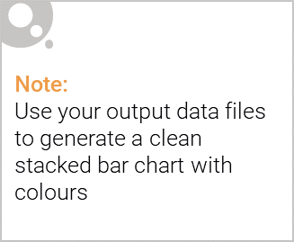
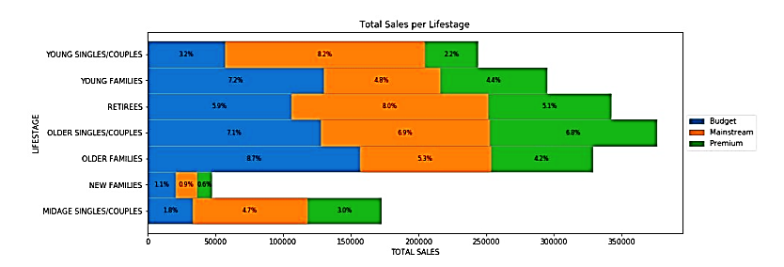
Editable (delete this)
Stretch: Try visualising the proportion of customers by affluence and life stage on this slide:
The primary sources of sales were the Budget - Older Families, Mainstream - Young Singles/Couples, and Mainstream - Retirees segments. In aggregate, older customer demographics made more purchases compared to their younger counterparts.
Furthermore, non-premium customers exhibited higher purchasing frequency than premium customers.

Slide 8
02
Trial store performance

Slide 9
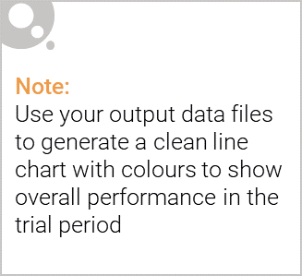
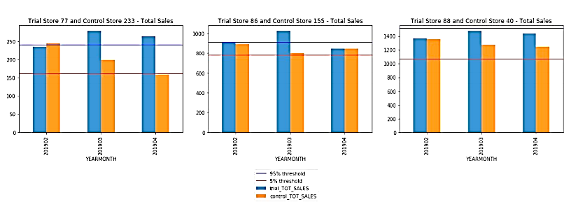
Explanation of the control store vs other stores:
Observing the sales data, it is evident that for the months of February, March, and April, Trial Store 77 consistently surpasses the 95% threshold in comparison to its respective control store. The same trend is observed for Trial Store 86 in all three trial months.
Conversely, the increase in sales for Trial Store 88 is deemed statistically insignificant.

Slide 10
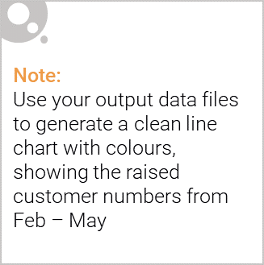
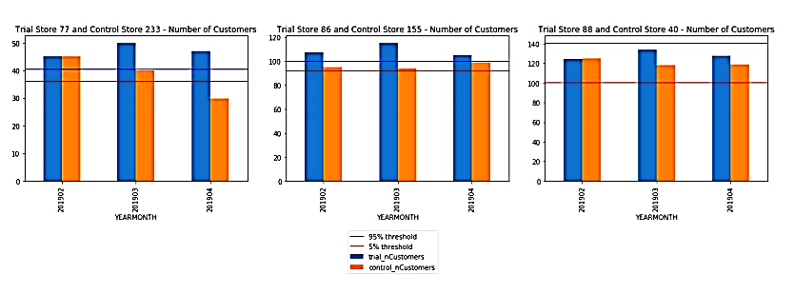
Call out of the performance in the trial store, determining if it was successful:
Trial Store 77 underwent a comparative analysis with Control Store 233.
Likewise, Trial Store 86 was assessed in relation to Control Store 155.
Similarly, Trial Store 88's performance was evaluated against Control Store 40.
Notably, Trial Stores 77 and 86 displayed a substantial upturn in Total Sales and Customer Count throughout the trial period. However, Trial Store 88 did not experience a corresponding surge. It may be prudent to consult with the client to identify any unique characteristics of Trial Store 88 that might account for this deviation from the other two trials.
In summary, the trial yielded positive and statistically significant outcomes.

